Slide 1
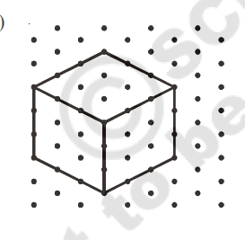
VISUALIZNG 3D SHAPES
.
3d shape
Isometric view
FACES
EDGES
VERTICES
NET
RESET

Slide 2
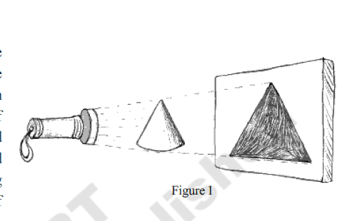
VISUALIZNG 3D SHAPES
.
Cross section/ 2D PROJECTION
RESET

Slide 3
DESIGN TEAM
BUILD A GOOD IMAGE FOR EACH OF THE MENU BUTTONS. – SEE BELOW LIST.
YOU HAVE TO CREATE MENU BUTTON AND AN IMAGE FOR DISPLAY.
CLICK ON A BUTTON AND CLICK IN DRAWING AREA. IT SHOULD DRAW THE CORRESPONDING OBJECT.
LEFT HAND MENU
CUBE, CUBOID, CYLINDER, CONE, PRISM, PYRAMID, CONE
DESIGN TEAM HAS TO BUILD ISOMETRIC VIEWS ON ISOMETRIC DOT PAPER.
THREE BUTTONS – FACES, EDGES, VERTICES
SEE NEXT SLIDE – NEED TO CREATE CROSSECTION WITH LIGHT ON / OFF
PROGRAMMING NOTES:
1. click on a shape
Divide the page into 3 parts – top 2 and bottom half
2. show the 3d model of it
3. show the isometric view of it
4. give the option to highlight - faces, edges, vertices. PROVIDE BUTTONS THAT WILL TOGGLE
5. SHOW NET
6. show the cross section IN SECOND TAB. SEE THE NEXT SLIDE FOR THE LIGHT EXPEIRIMENT. CLICK ON THE OBJECT ON LEFT, IT SHOULD DISPLAY IN THE PICTURE. WE SHOULD HAVE A LIGHT SWITCH ON /OFF. SWITCHING ON THE LIGHT SHOULD SHOW THE 2D IMAGE
TEACHING GUIDE – WILL NEED DEFINITIONS FOR EACH ITEM AND EXPLANATION ABOUT THE VARIOUS MENU OPTIONS

Slide 4
EXAMPLE FOR ISOMETRIC VIEW OF CUBE – CAN WE SHOW SIMILAR EXAMPLES FOR ALL SOLIDS
Torchlight should have on/off feature.
The solid object in middle will change.
The 2D projection should be based on the solid object.

